Slide 1
Bellabeat Case Study
Data Analysis & Marketing Recommendations
Author: Sulay Cay
Date: 05-Jan-2025

Slide 2
Introduction
Bellabeat, a wellness technology company, aims to leverage insights from smart device data to optimize its marketing strategy and promote its products. By analyzing user activity, calorie expenditure, and behavioral trends, this report provides actionable recommendations tailored to Bellabeat's mission of empowering women to achieve healthier lifestyles.

Slide 3
Business Task
Objective: Analyze trends in smart device usage to uncover patterns that inform product development and marketing strategy for Bellabeat.
Key Questions:
1. What are the trends in smart device usage?
2. How do these trends relate to Bellabeat’s customers?
3. How can Bellabeat use these trends to refine its marketing strategy?

Slide 4
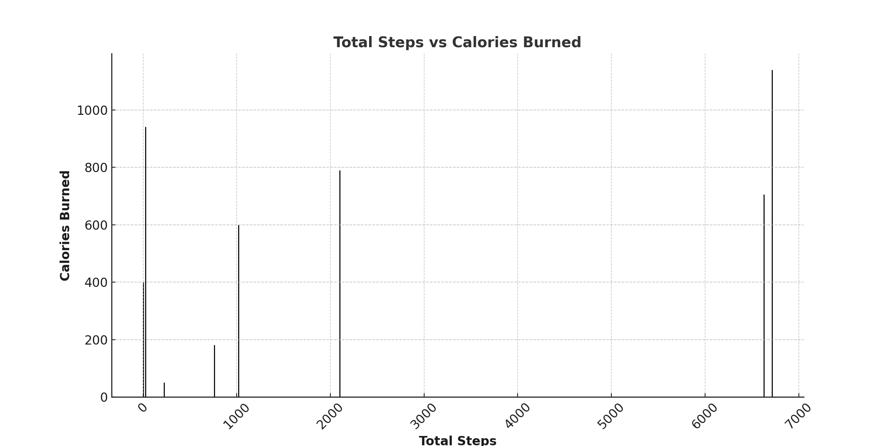
Visualization: Total Steps vs Calories Burned

Slide 5
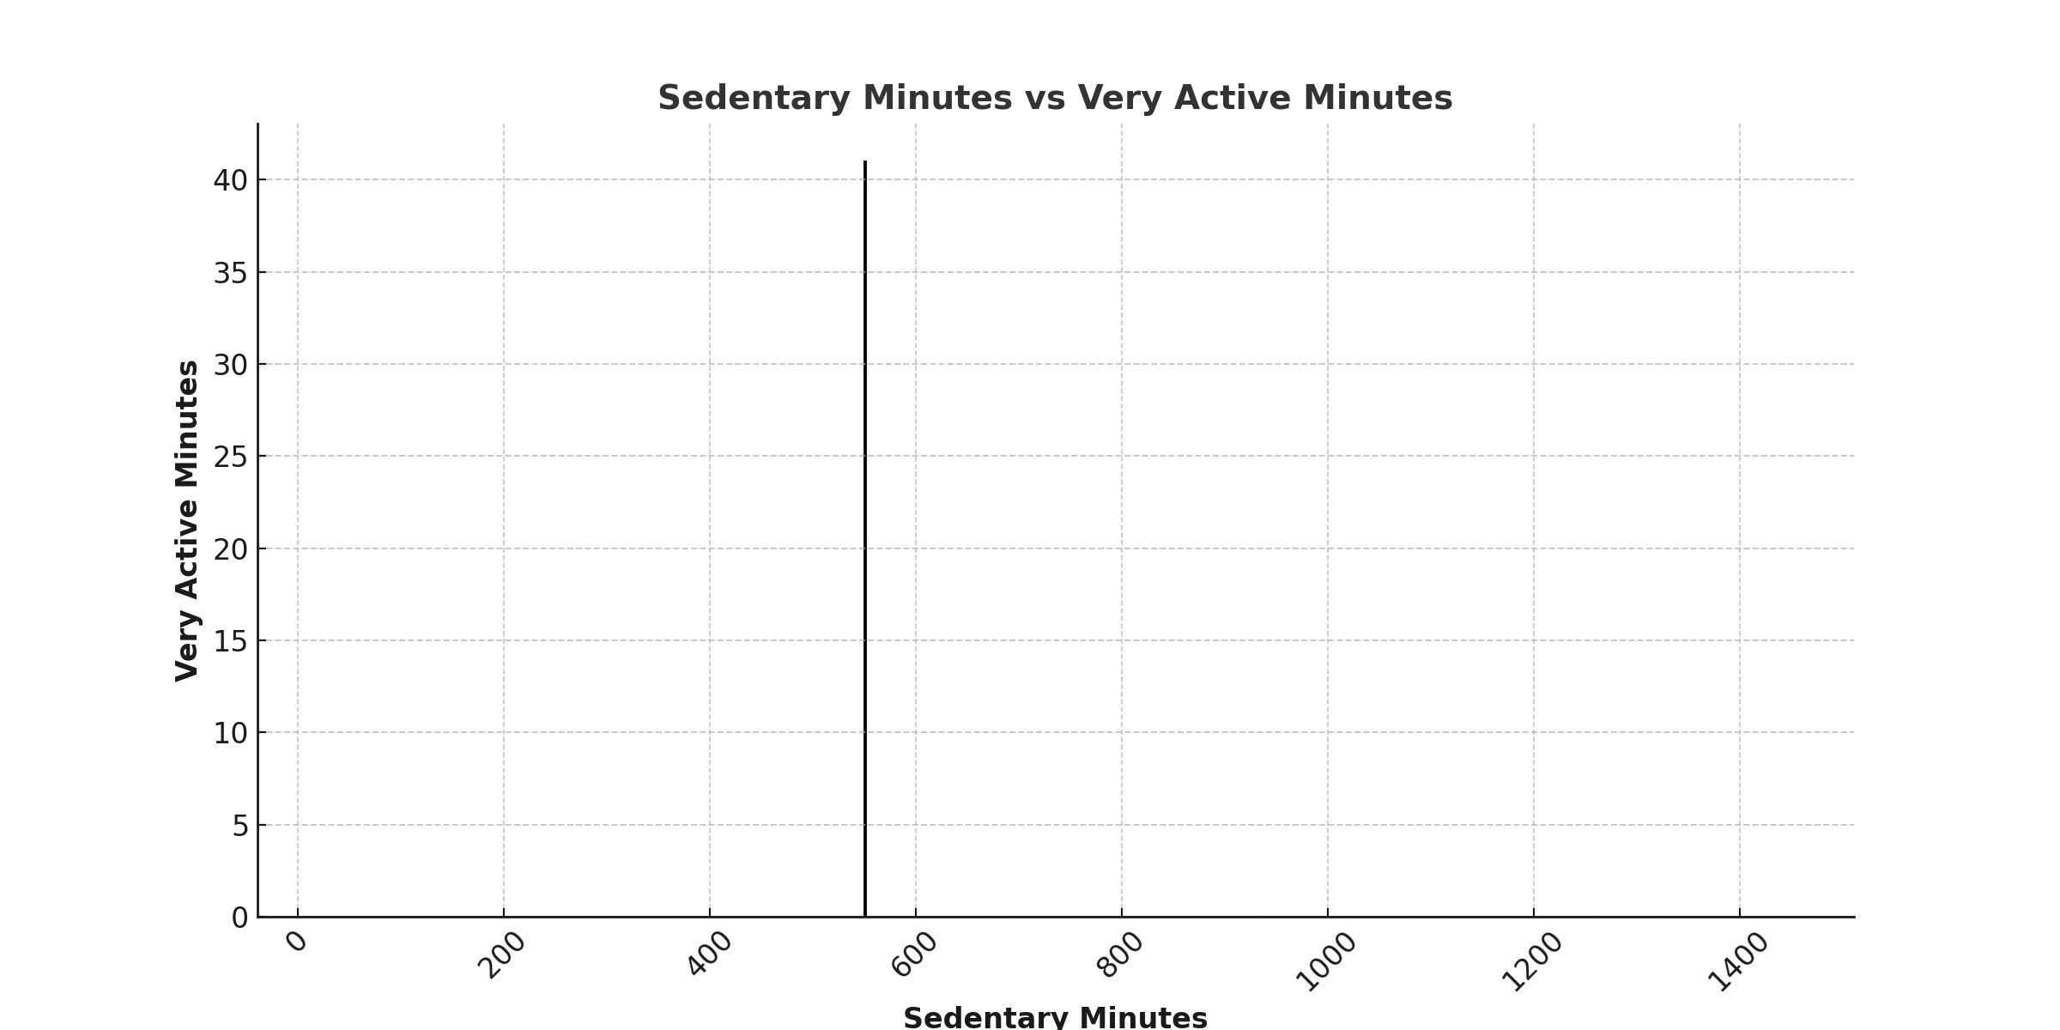
Visualization: Sedentary vs Very Active Minutes

Slide 6
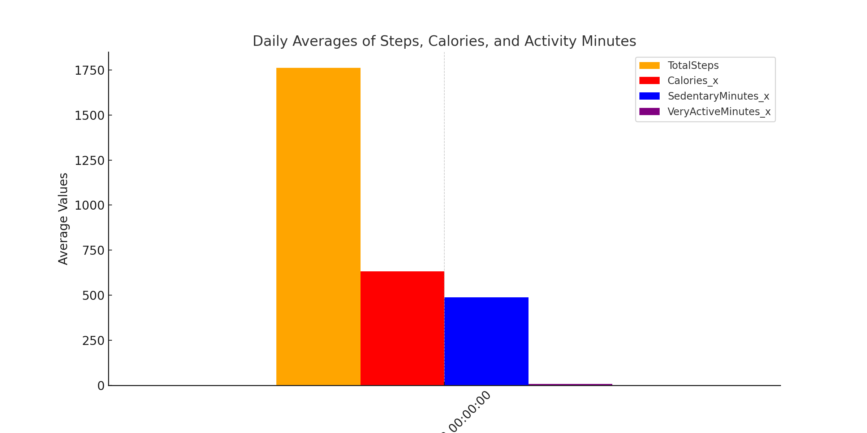
Visualization: Daily Trends in Activity

Slide 7
Conclusion
By leveraging data-driven insights, Bellabeat can enhance user engagement and refine its marketing strategies. Personalized activity goals, gamification, and integrated insights provide clear pathways for growth while empowering users to lead healthier lives.
Next Steps:
1. Implement these recommendations within Bellabeat’s app and marketing platforms.
2. Monitor and refine strategies based on user feedback and additional data analysis.

